Slide 1
DRIVING FEATURE EXTRACTION

Slide 2
Data Science Flow
Let`s start!
1
Data Collection
Data Preprocessing
2
3
This project
Feature Extraction
Transformation
4
5
Feature Selection
Experiment Design
6
Cross Validation
7
Result Analysis

Slide 3
topic
What you can learn p.4
Problem definition p.6
ICA p.10
Experiment p.14
Conclusion p.19

Slide 4
What you can learn

Slide 5
What you can learn
1. independent component analysis : theory, intuition, suitable condition.
2. decompose signal data

Slide 6
Problem definition

Slide 7
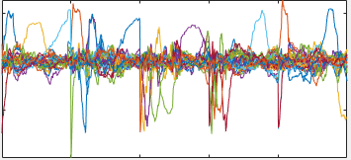
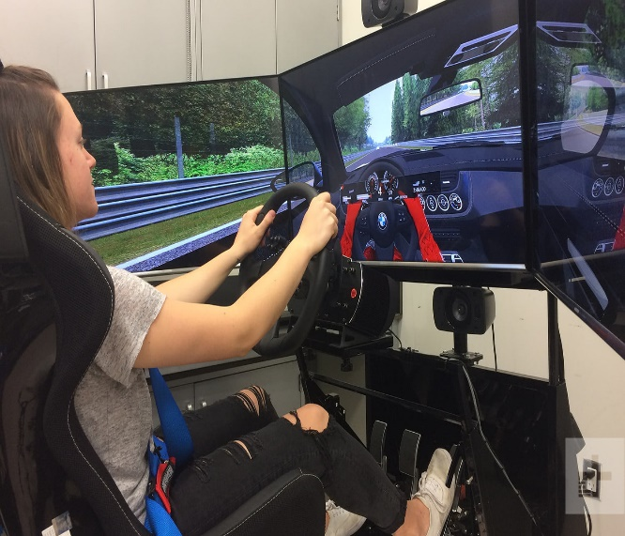
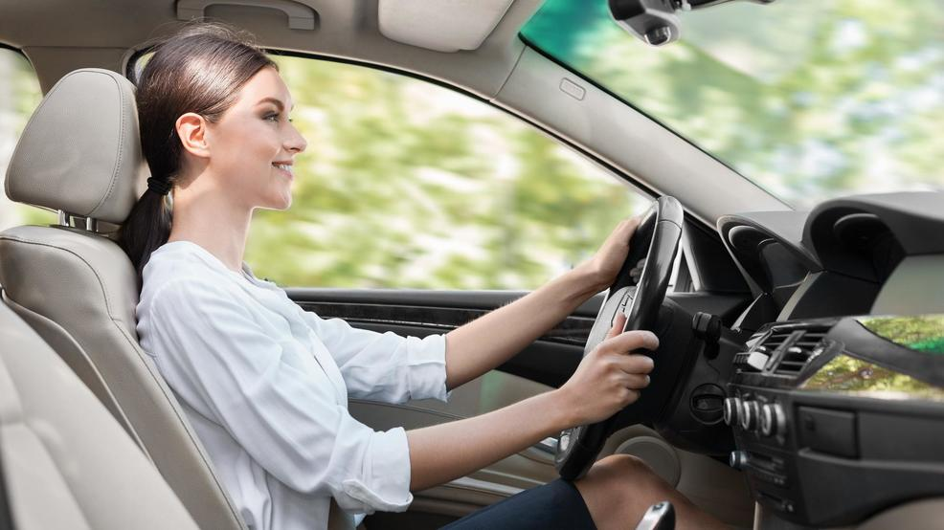
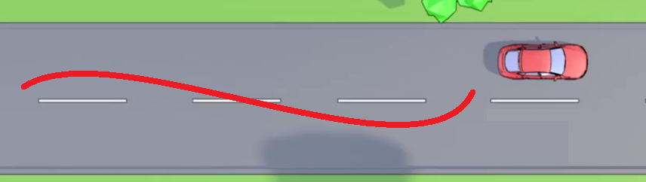
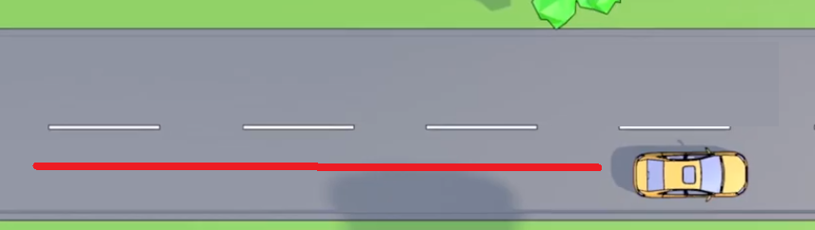

Problem definition
ICA
 | Simula- tion | Real
Normal | SN | RN
weaving | SW | RW
Notes:
identify safe/unsafe behavior (drunk and so on) --> need real driving behavior signal data --> dangerous --> need synthesis to generate data that similar to real data from existing signal data --> current generation method (eg: GAN) still need a small number of real data --> our ide is to decompose the signal (environment and behavior) and then combine it according to the signal we desired.

Slide 8
simulation
behavior
ICA
environment
noise
compare
real
behavior
ICA
environment
noise

Slide 9
Background + reason to use ICA
ICA work on the situation that data contain several source signals. In our case, when we collect the smartwatch data, it contain the driver’s behavior and the vibration from the car’s engine.
ICA can decompose the sequentially signal. In our case, the data is sequentially signal, the data length is between 600 ~ 1300.

Slide 10
Problem definition
The final goal is to use smartwatch to identify whether the driver is drunk driving or not.
In order to do this, the first step is to have drunk driver’s behavior.
But it is nearly impossible to get this data in real environment. So we do it in simulation environment.
To make it more realistic, we decompose the environment’s feature and behavior’s feature. And combine the real environment’s feature and weaving(drunk) behavior’s feature.

Slide 11
ICA

Slide 12
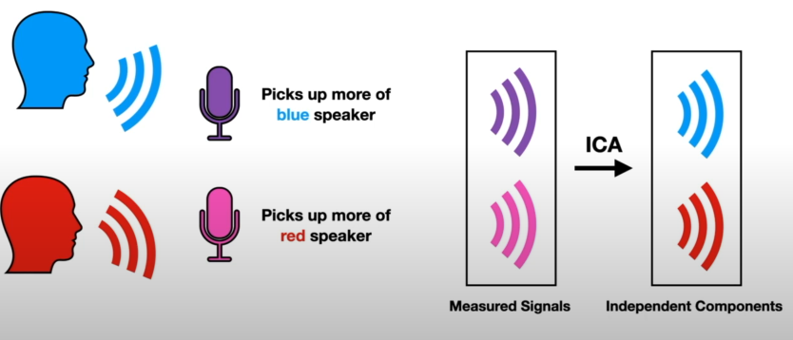
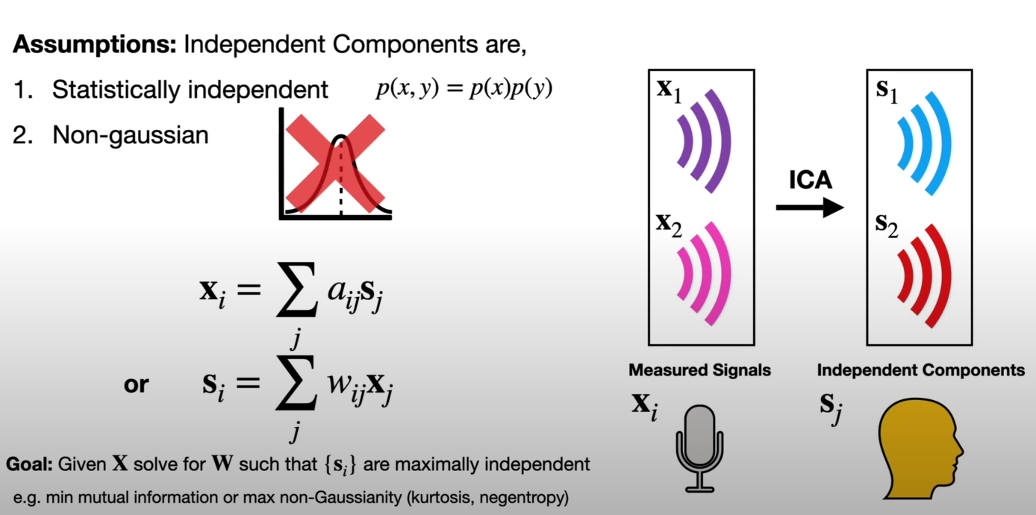
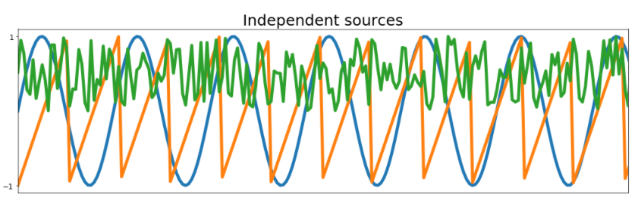
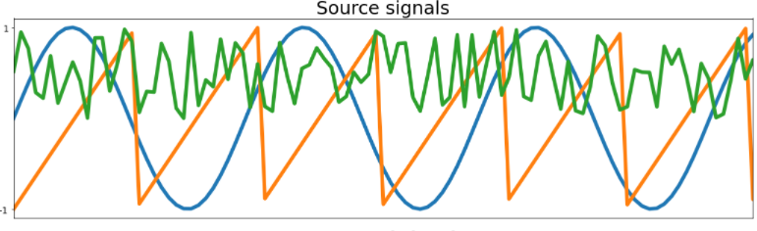
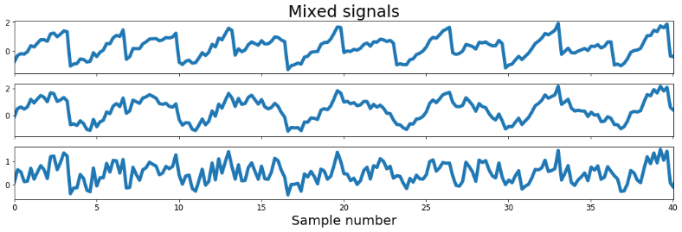
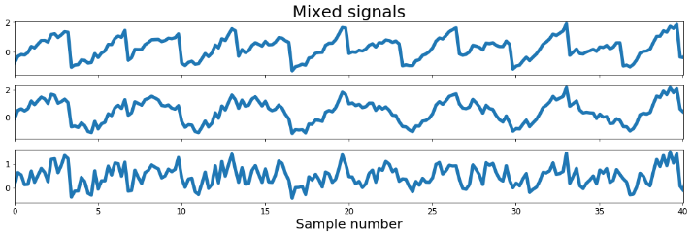
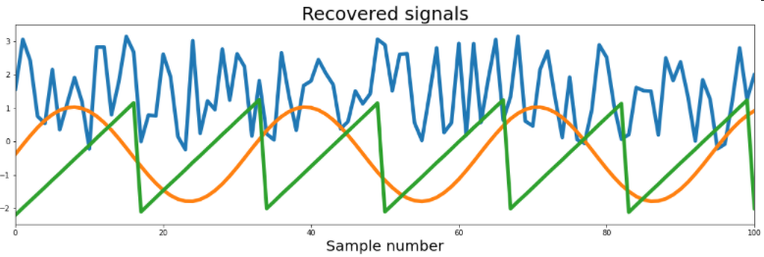
DECOMPOSING COMBINING & SIGNALS
General Case that can be
Solved using ICA
Our Case
Environment
Cocktail Party Problem
COMBINING SIGNALS
DECOMPOSING SIGNALS
Smartphone
Smartwatch
Behavior
STEPS
$$p\left(x1,x2\right)=p\left(x1\right)p(x2)$$
ICA
RELATED WORKS
STEPS
RELATED WORKS
STEPS
START
Mixed Signals
Sine wave
Saw-tooth signal
Random noise signal
Ensuring the Data
Preprocessing
ICA Signals decomposition
Independent Components
END
https://scikit-learn.org/stable/auto_examples/decomposition/plot_ica_blind_source_separation.html
Notes:
There are two key assumptions made in ICA. The hidden independent components we are trying to uncover must be one, statistically independent, and two, non-Gaussian. Semantically, by independent I mean information about x does not give you information about y and vice versa. Mathematically, this translates to,

Slide 13
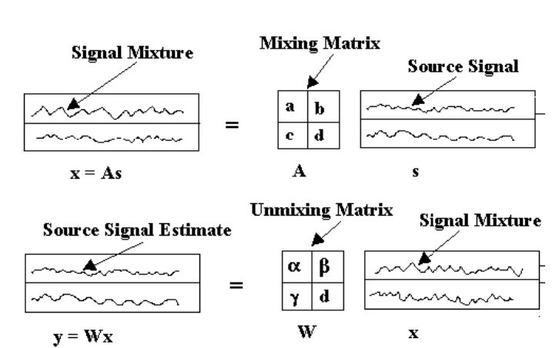

Slide 14








3 X + 2 Y = 7
X + Y = 3
$$\left[\begin{matrix}3 & 2 \\ 1 & 1\end{matrix}\right]$$
$$\left[\begin{aligned}X \\ Y\end{aligned}\right]$$
$$=$$
$$\left[\begin{aligned}7 \\ 3\end{aligned}\right]$$
$$\left[\begin{aligned}X \\ Y\end{aligned}\right]$$
$$\left[\begin{matrix}3 & 2 \\ 1 & 1\end{matrix}\right]$$
-1
$$\left[\begin{aligned}7 \\ 3\end{aligned}\right]$$
$$=$$

Slide 15
Experiment

Slide 16
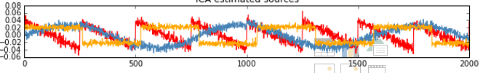
Experiment
Our data contain three driver driving in simulation environment and real environment with weaving behavior and normal behavior.
Ex.
Simulated Safe of Driver A
Find the signal that have high similarity (..) → behavior
Simulated Safe of Driver B

Slide 17
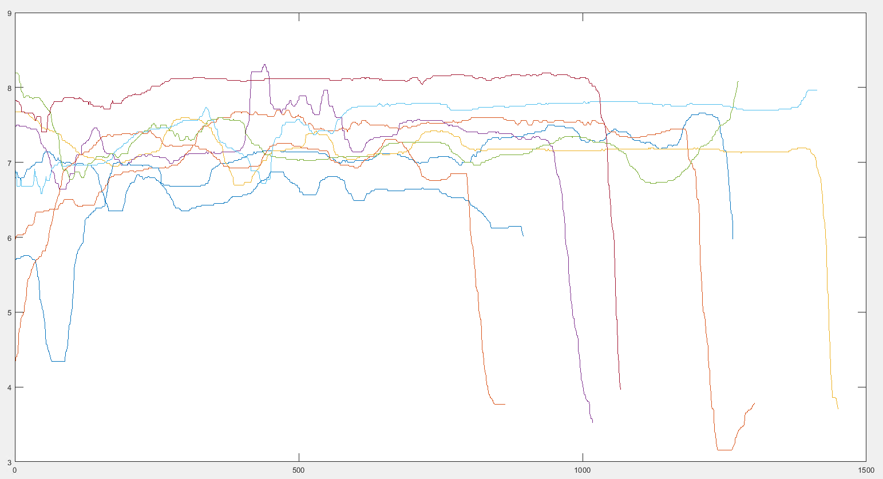
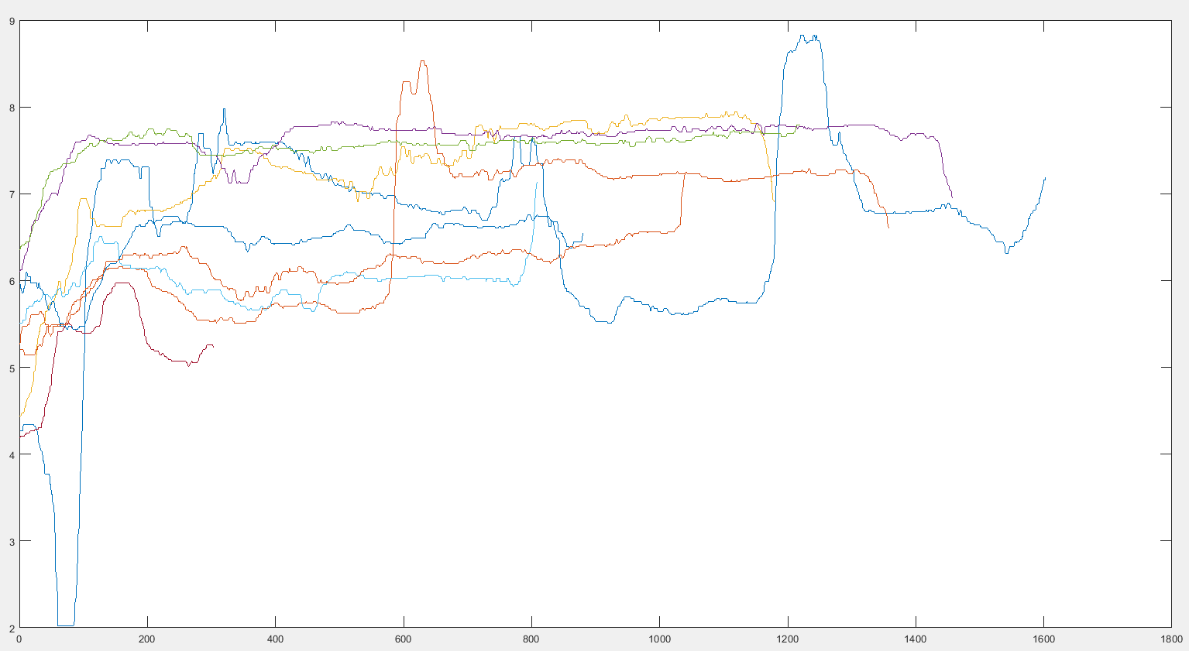
Experiment: simulation normal
Raw data :
Driver 1
Driver 2

Slide 18
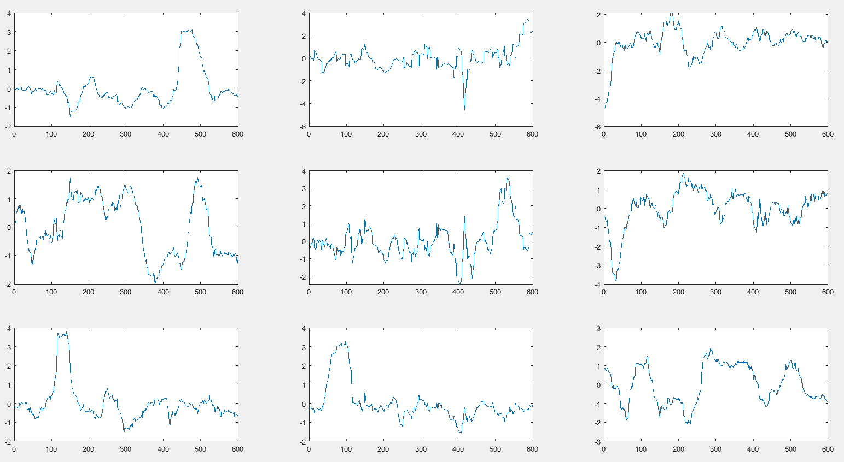
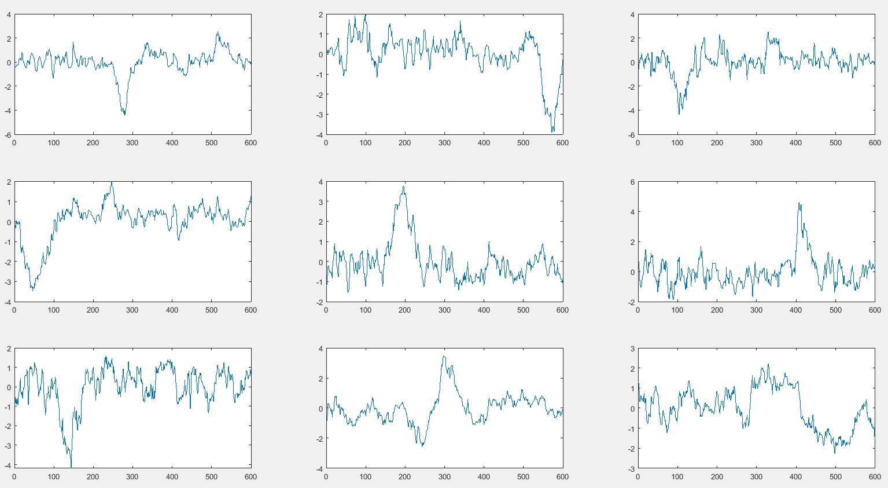
Experiment: simulation normal
ICA result:
Driver 1
Driver 2

Slide 19
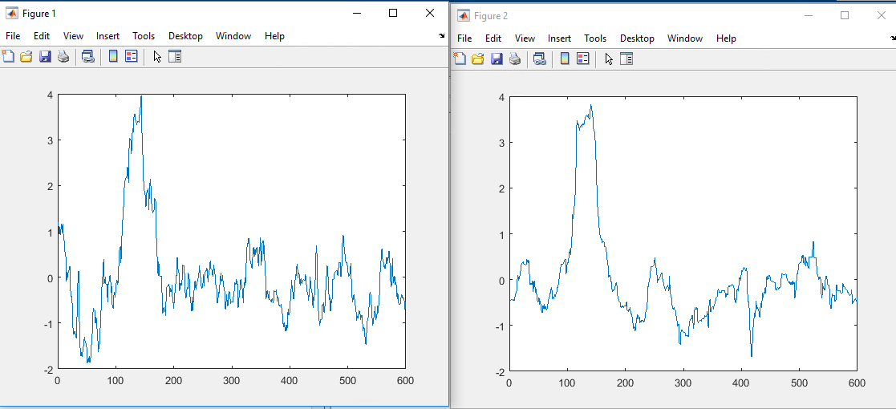
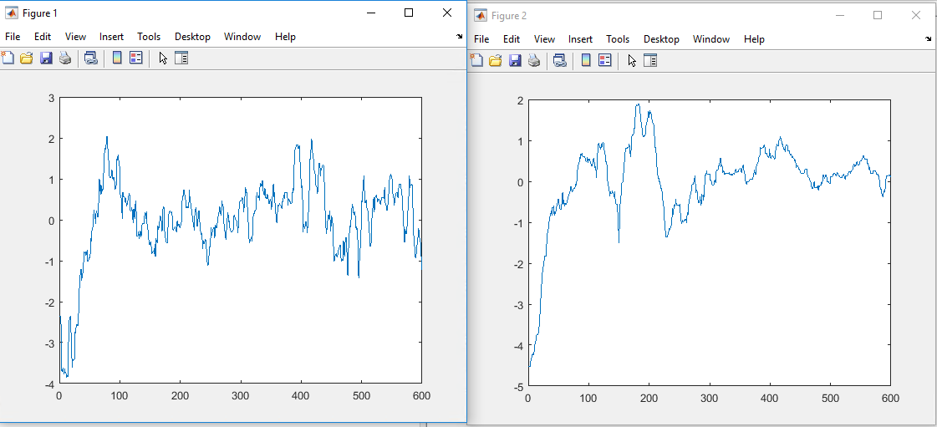
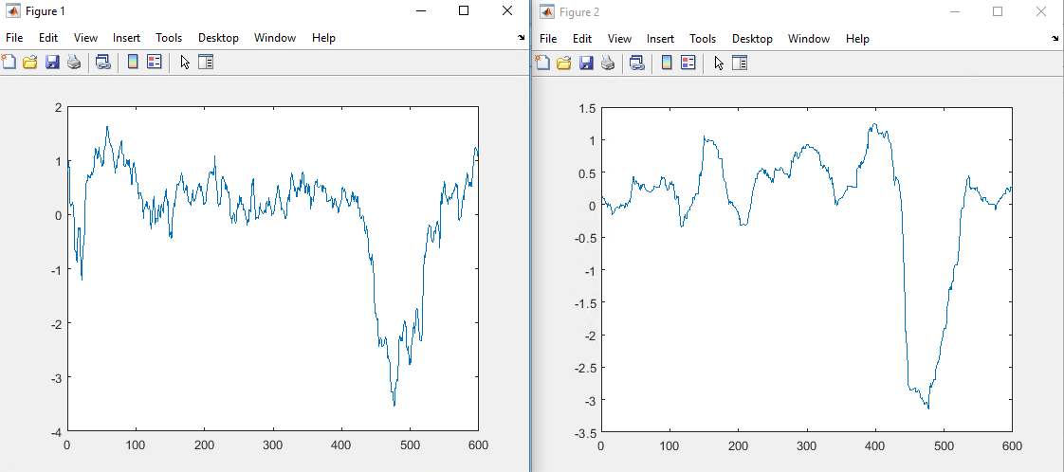
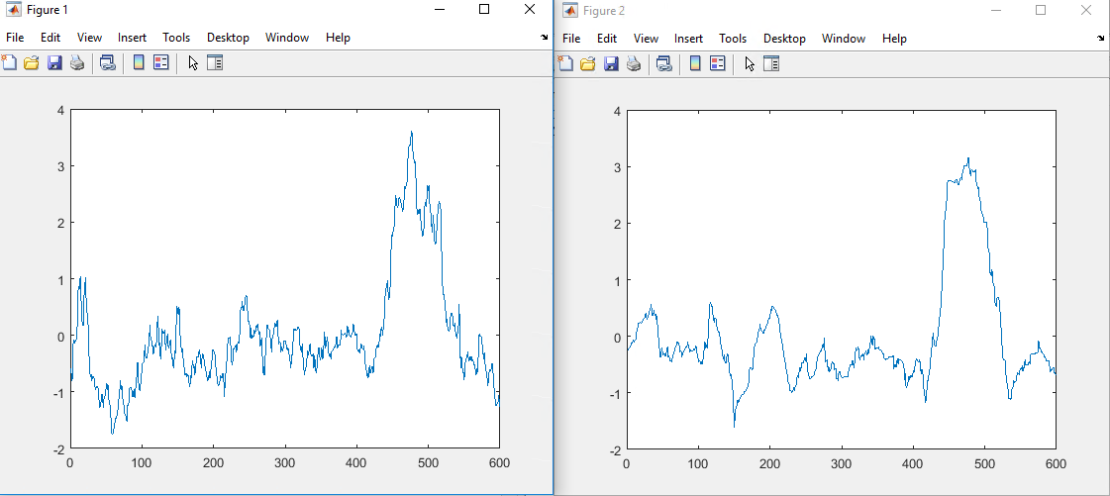
Experiment: simulation normal
We find several similar signal. We assume this is the feature of behavior.

Slide 20
Conclusion

Slide 21
Conclusion
For now, we found the signals that are 70% similar. Which proves this decomposition work.
In our assumption, it is the behavior’s feature signals.

Slide 22
END

